Slide 1
Machine Learning:
Investing on P2P Loans
Ricky Gunawan
Akshay Jindal
Onur Baser

Slide 2

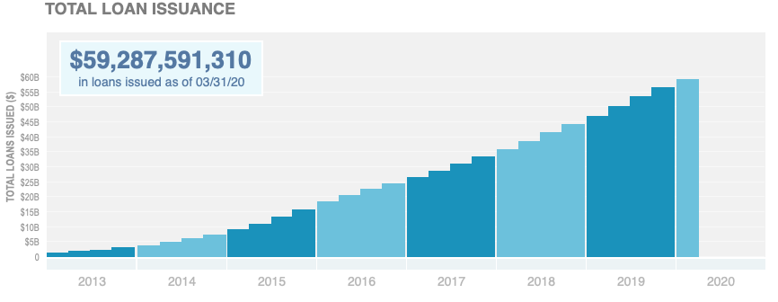
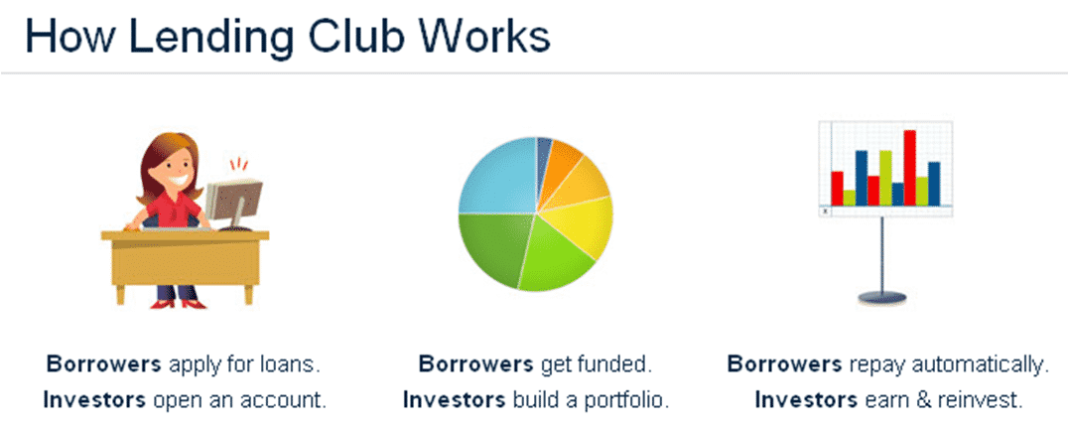
Background
As the global interest rates benchmark are heading to zero, it is interesting to look at alternative loan investment that provides promising potential return.
We choose Lending Club loan investing and the platform gives us access to large loan datasets (up to ~5millions loans count per quarter)

Slide 3
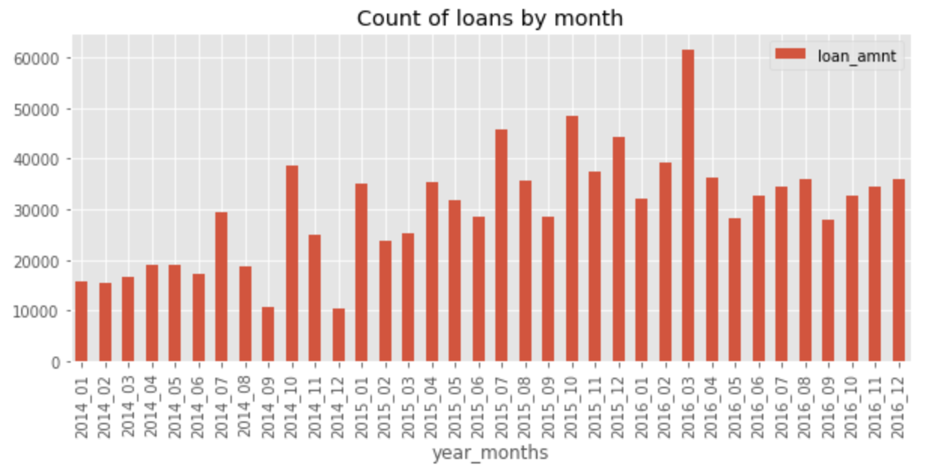
Initial Data Analysis
We choose to focus our analysis on 2014 - 2016 period, which had similar low interest rates regime as today (i.e. Fed Fund Rates range between 0 to 25bps)
During this period we have about 1.1 millions loan data with 151 features
We did TONS of data cleaning and apply data visualizations

Slide 4
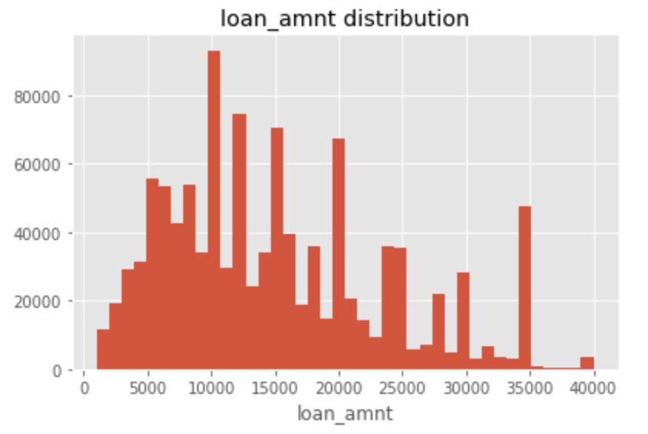
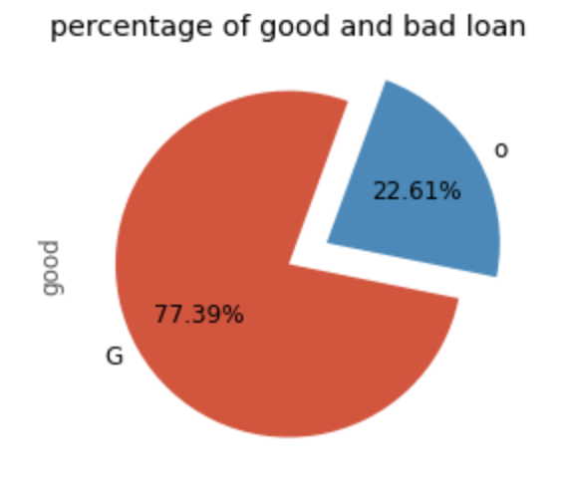
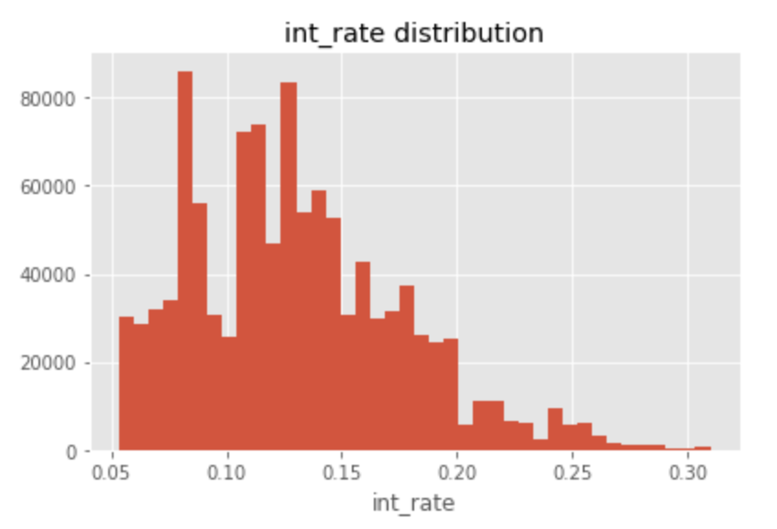
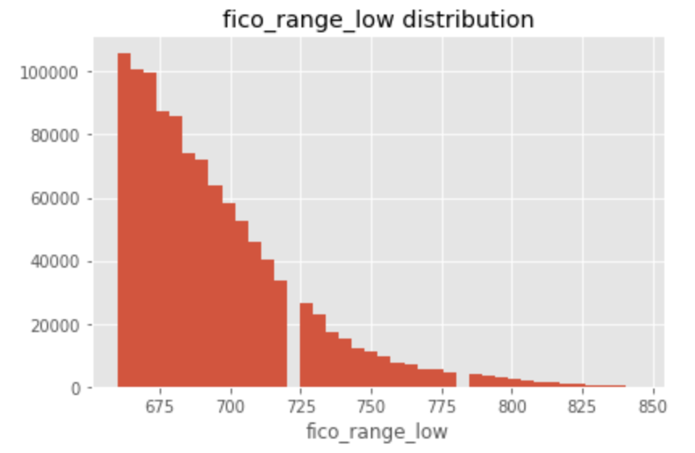
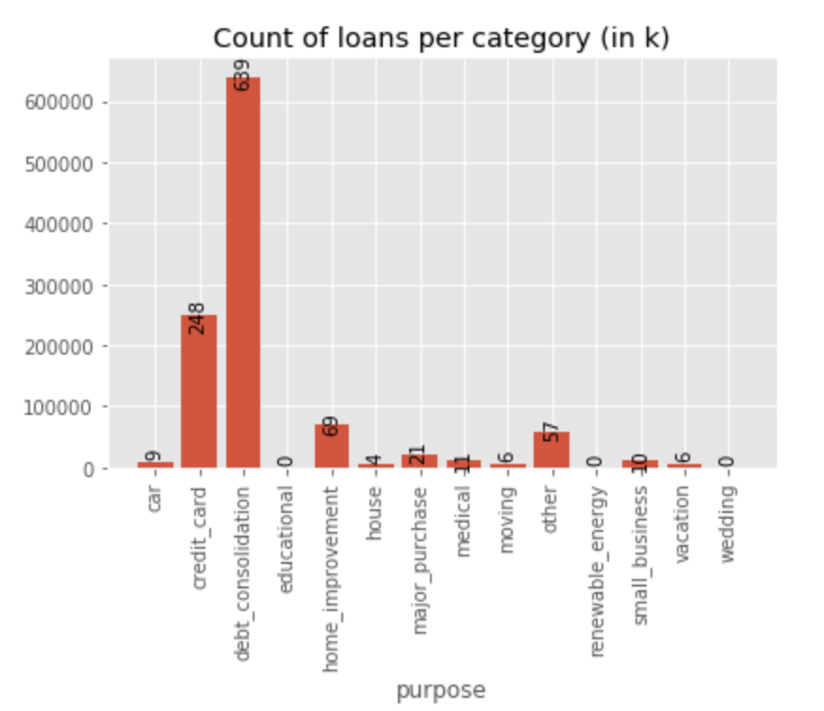
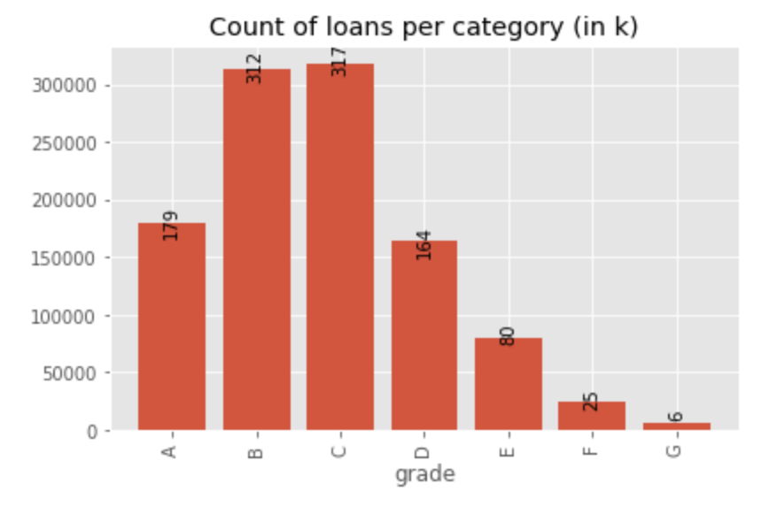
Initial Data Visualization Analysis

Slide 5
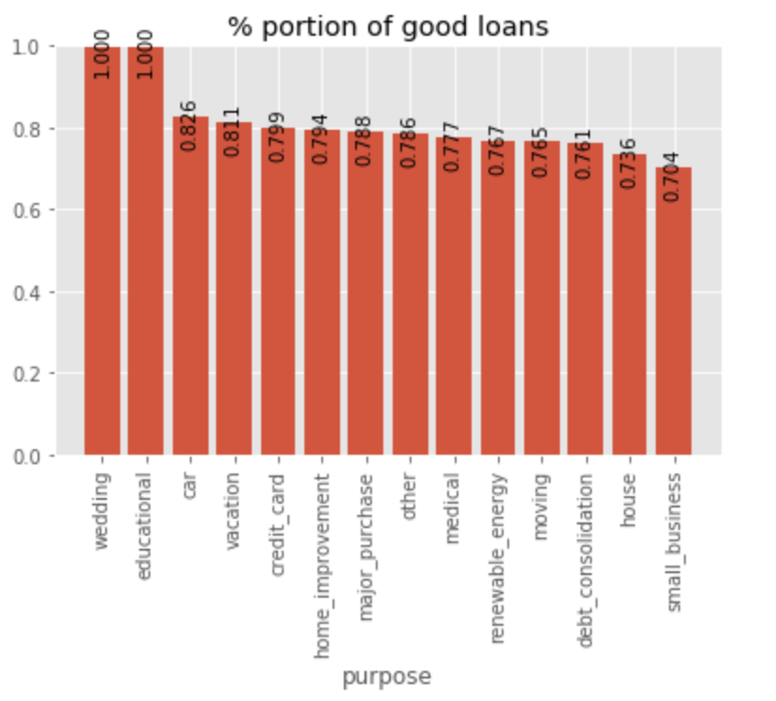
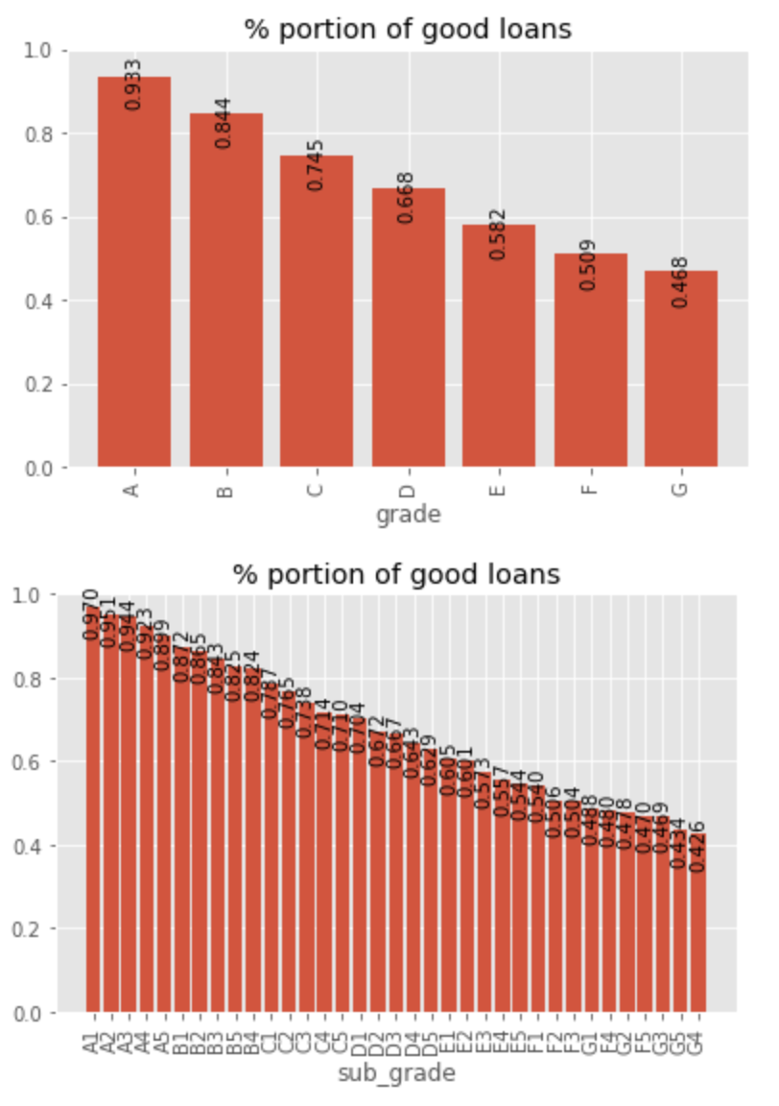
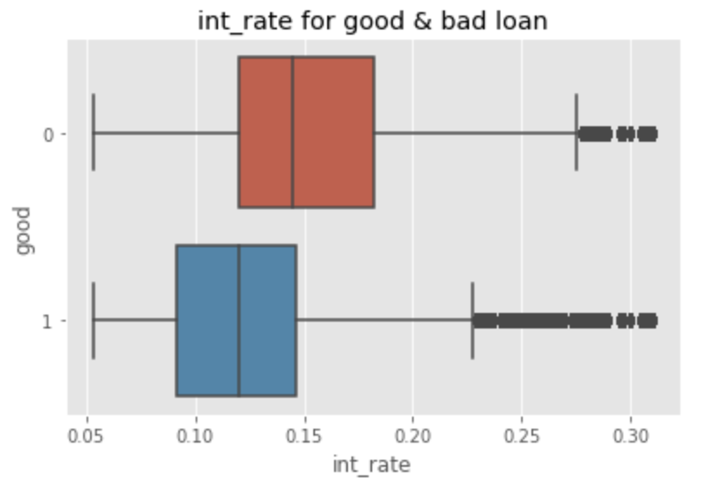
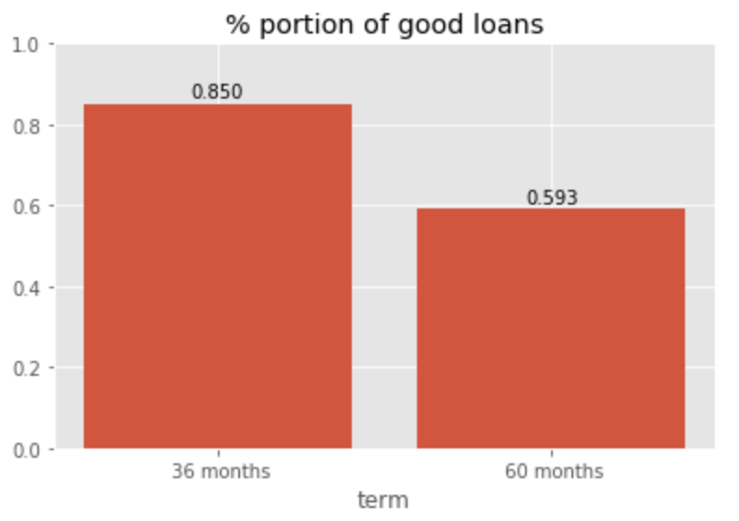
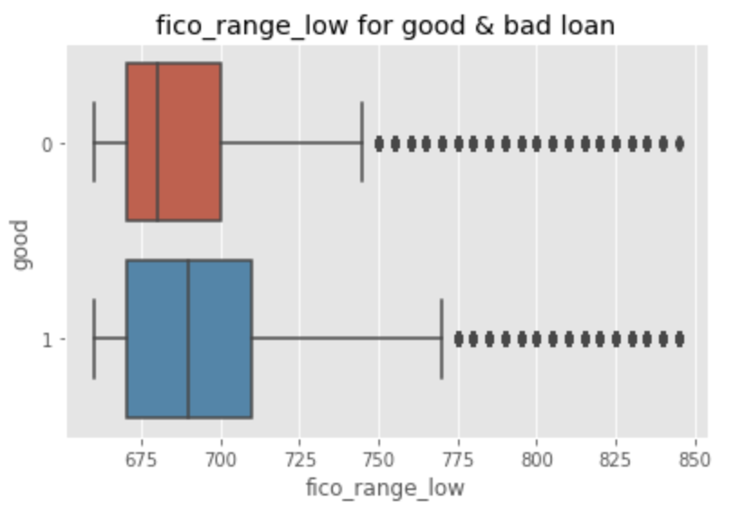
Good Loans Data Visualization Analysis

Slide 6
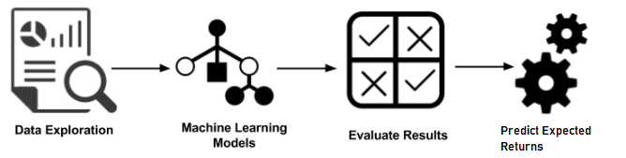
Programming Objectives
Determine the features in the dataset and calculate returns for each loans in the dataset
Test multiple classifiers model to predict good loan and bad loan
Random Forest, Logistic Regression, Decision Tree, Gradient Boosted Tree, LSTM RNN
Select one model and explore on how to increase precision by taking the top percentile of probability of predicting good loan
Calculate the loans expected return - Hopefully we can see enhancement on return here :)

Slide 7
Features Selection

Slide 8

Features Selection Methodology
Machine Learning Method:
Use classification models to determine important features
Random Forest Decision Tree
XGBoost
Research Method:
Academic articles
Case studies
Kaggle
Notes:
Inituative understanding derived from raw data analysis (including the visualization that we shared in previous slides)
Applied Research methods coupled with machine learning to deterime the top 20 features that would best represent a “good” loan

Slide 9
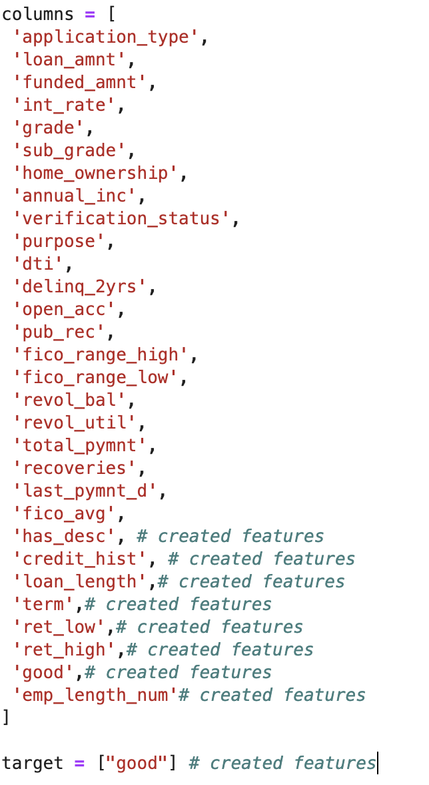
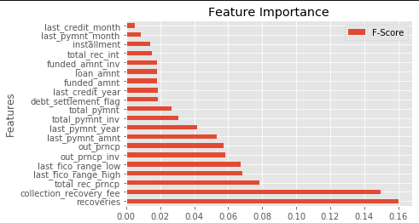
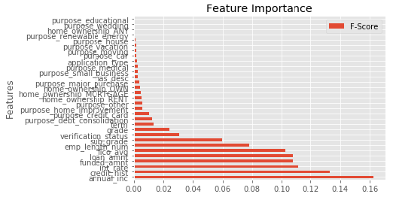
Identifying Important Features
9 additional features were created on top of the 22 features
We are selecting features that are known during the initiation of the loan, so features like recoveries, total payment, collection recovery fee are excluded for X training
Random Forest with all raw features
Random Forest with selected features
Notes:
Created new features to quantify data such as employment length and credit history
To the right, we can see a quick snapshot of the various features used and the ones that were added
The objevtive was to identeity pertains of the intiation of the loan

Slide 10
2. Classification Model Selection

Slide 11

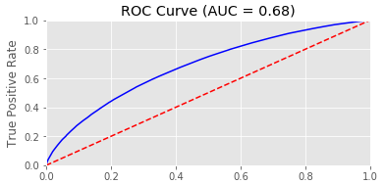
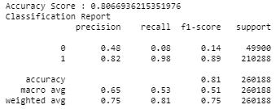
Random Forest Tree
Notes:
ROC CURVE
LTSM (ROC)
Results and ROC curve

Slide 12

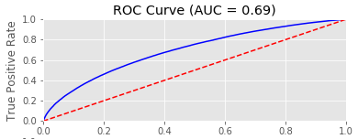
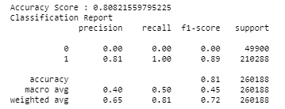
Logistic Regression

Slide 13
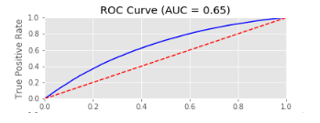

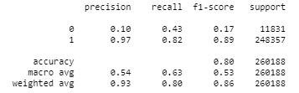
LSTM Neural Network

Slide 14
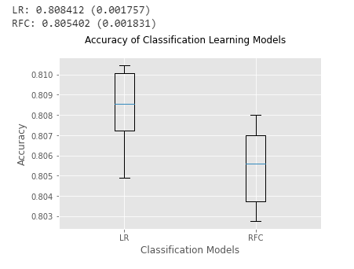
Why we choose Random Forest
Logistic Regression: High accuracy, High standard deviation, more outliers
Random Forest: High accuracy Low standard deviation, less outliers
Notes:
Everytime you run the model, the outliers seem to change…?

Slide 15
3. Random Forest

Slide 16
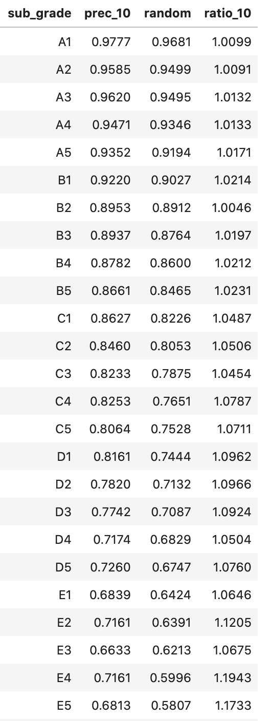
Random Forest at sub grade level
Training using 31 features for each sub grade from A1 to G5
Calculate probability of good loans (precision) for random investment and top 10th percentile predicted probability
Looking at C1, random investment produces 82% of good loans. If we take top 10% of predicted probability, it would produce 86% of good loans (5% improvement)

Slide 17
4. Return on Investment Analysis

Slide 18
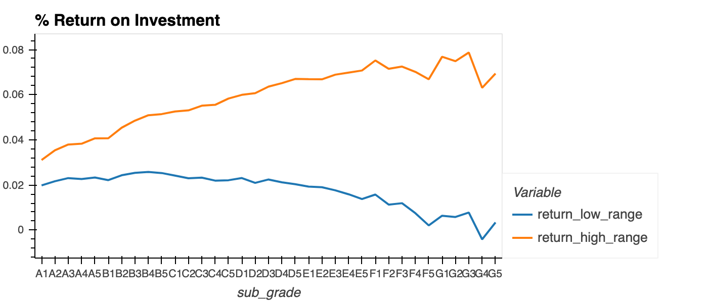
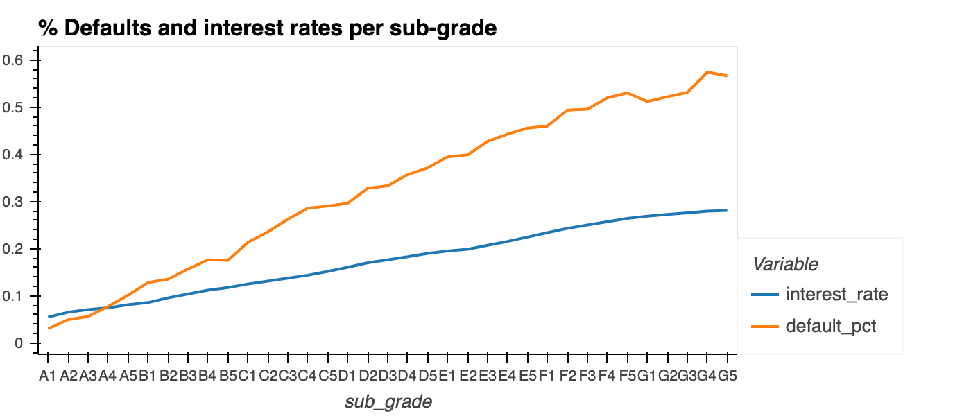
Return calculation for each loan
For every loan in the given dataset, we calculated annualized return on investment
High range (optimistic) return: (total loan payment - initial investment) * 12 / age of the loan in month
Low range (pessimistic) return: (total loan payment - initial investment) * 12 / term of the loan in month
High range return ranging from 3% to 8% and Low range return ranging from 2% to -0.4%
Notes:
Ret_low: The downside of this method is obvious—the assumptions are hardly realistic. Note that this method handles defaults gracefully, without artificially blowing up the returns. Indeed, since the investor was initially intending for his or her investment to remain ‘‘locked up’’ for the term of the loan, it is reasonable to spread the resulting loss over that term. For loans that go to term (i.e., are not repaid early and do not default), this method also treats long- and short-term loans in the same way. For loans that are repaid early, however, this method favors short-term loans because the gain realized before the loan is repaid is spread over a shorter time span. Similarly, for loans that default early, this method favors long-term loans because the loss is spread out over a greater time span.
Ret_high:
The upside of this method is that it is simple and takes into account the fact that funds would (or could) be reinvested. The money is indeed returned to the investor after the loan is repaid, and the investor is able to reinvest the cash. It is worth noting that this method is equivalent to simply considering the annualized monthly return of the loan over the time it was active, effectively treating a loan that was repaid early and a loan that went to term in the same way. There are, however, two drawbacks. The first is the assumption that the cash can be reinvested at the same rate (although the method could be modified to assume the cash can be reinvested at a lower rate—e.g., the prevailing prime rate). The second more worrying drawback is that if a loan defaults early, annualizing the loss can result in a huge overestimate of the negative return. Indeed, if a loan defaults in the first month, the investor loses 100% of the investment. This is the maximum loss, but annualizing it would lead to a 1200% loss—in other words, we would be assuming the investor reinvests in an equally risky loan for the 11 remaining months of the year, each of which defaults in 1 month! Hardly realistic. One last feature worth noting about this method is that it treats short and long notes equally. Indeed, since it is assumed the investor can always reinvest in a note of equal return immediately after this note ends, the actual term of the loan does not matter. Depending on Jasmin’s priorities, this could be appropriate, or it could not—in particular, whether this is appropriate will depend on the horizon over which she is planning her investments.

Slide 19
Returns Calculation after applying Random Forest
For every loan in the given dataset, we calculated annualized return on investment
From here, we grouped by “Good Loan” and “Defaulted Loan” and able to calculate the expected return of each Good and Defaulted loan at sub_grade level
Utilizing Random Forest Classifier that we applied at sub_grade level and selecting to 10th percentile probability, we were able to get the precision or probability of predicting good loan P(good loan)
With the given probability above, we can calculate the new expected return at sub_grade level:
Expected Return = P(good loan) * R_{good} + P(defaulted) * R_{defaulted}

Slide 20
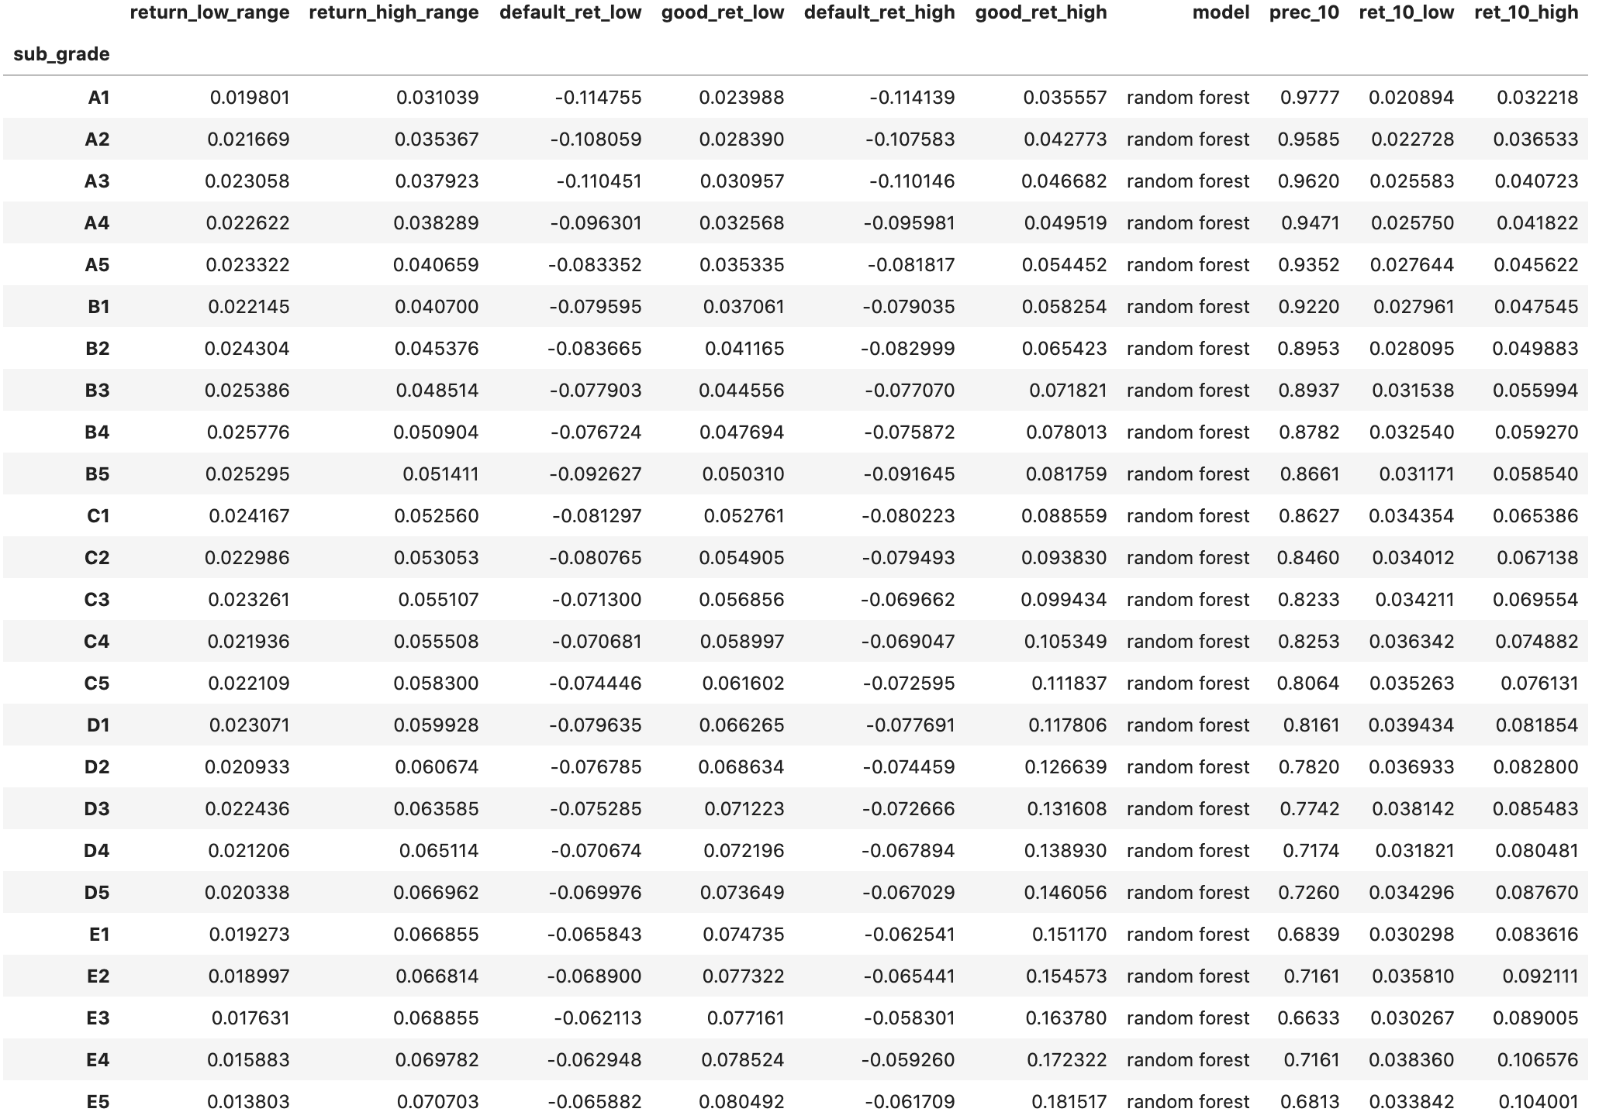
Return Dataframe

Slide 21
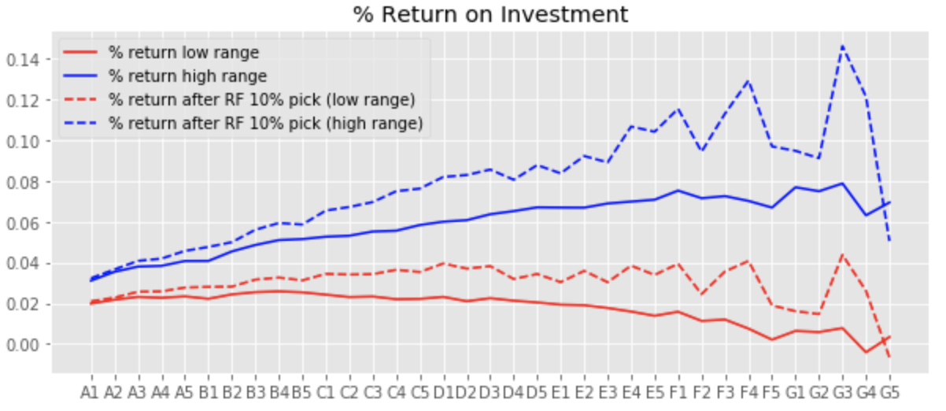
Returns Calculation after applying RF
For both low and high range return, the new expected returns are higher
Looking at C1 sub grade, the low range return increased to 3.4% from 2.4% and high range return to 6.5% from 5.3% after taking top 10% probability of good loan
At lower grades (F1 to G5) we started to see model instability, likely due to sparse data availability for training and testing

Slide 22
What would we do if we have more time?
Extend the study utilizing neural network model
Review the model using the more recent data and potentially add the ability to incrementally train the model as we get new data
Utilizing more of Google Colab or AWS as we are are dealing with larger datasets

Slide 23

BIG DATA

Slide 24
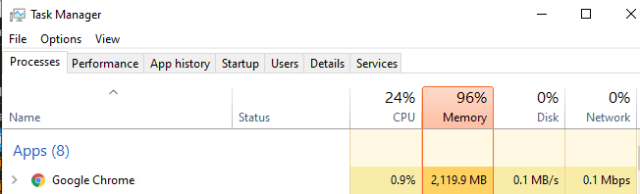
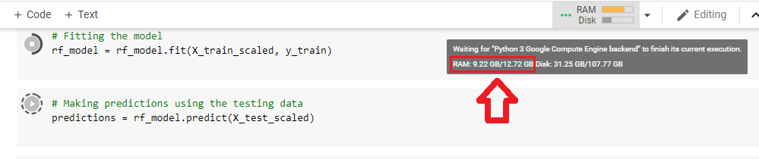
Processing Big Data
Cloud Computing application (Google Colab)
Utilized more memory for processing
Local Runtime: 20 - 45 min
Cloud Runtime: 5 - 10 min

Slide 25
Citations
https://www.lendingclub.com/info/statistics.action
https://www.liebertpub.com/doi/pdf/10.1089/big.2018.0092
https://towardsdatascience.com/understanding-auc-roc-curve-68b2303cc9c5
https://towardsdatascience.com/accuracy-recall-precision-f-score-specificity-which-to-optimize-on-867d3f11124
http://cs229.stanford.edu/proj2015/199_report.pdf
http://abhay.harpale.net/blog/machine-learning/threshold-tuning-using-roc/
https://machinelearningmastery.com/feature-selection-with-real-and-categorical-data/
https://www.researchgate.net/publication/322098019_Combination_of_Random_Forests_and_Neural_Networks_in_Social_Lending
https://www.cs.huji.ac.il/labs/learning/Papers/giladbachrachnavottishby04b.pdf
https://www.kaggle.com/janiobachmann/lending-club-risk-analysis-and-metrics
https://www.kaggle.com/pavlofesenko/minimizing-risks-for-loan-investments

